Slide 1

Watermelon Inc.
E. Cogotti | F. Pesciatini | G. Petrelli | M. Gómez

Slide 2
Augmented Reality Engine Application
Flexible development of location‑based mobile augmented reality applications with AREA
E. Cogotti | G. Petrelli

Slide 3

Introduction
Topic : mobile augmented reality
Issues:
• Dynamic OS enviroment • Costly and time-consuming development
Goal: flexible framework

Slide 4



What’s AREA and its Goals
AREA is a kernel to implement location-based AR applications
Cross-platform
Abstraction
Games development on top of AREA

Slide 5
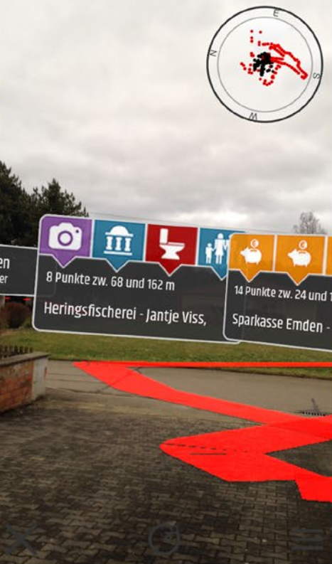
Algorithm Pillars
• Objects detected in the camera view • PoI, tracks, area, 3D objects • 3D world relate object and user • Physical camera adjusted w.r.t virtual 3D camera

Slide 6
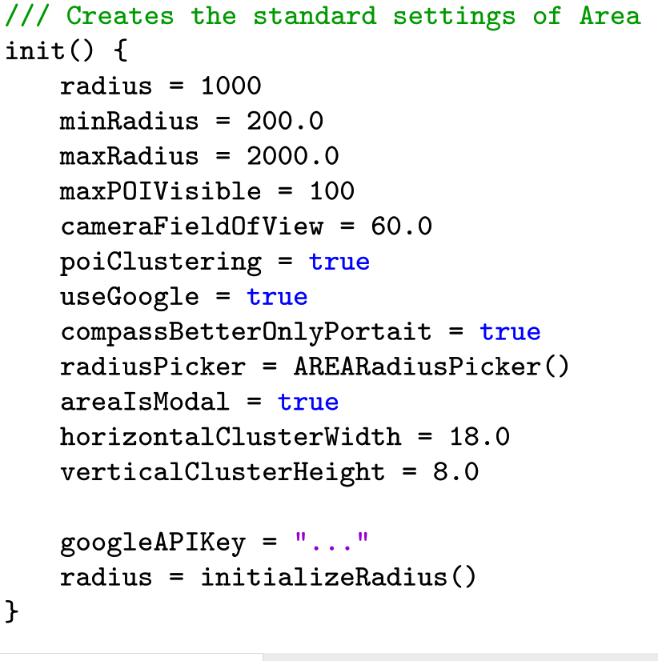
Standard AREA setting and sensors
Sensors:
• Camera • GPS • Compass • Gyroscope

Slide 7
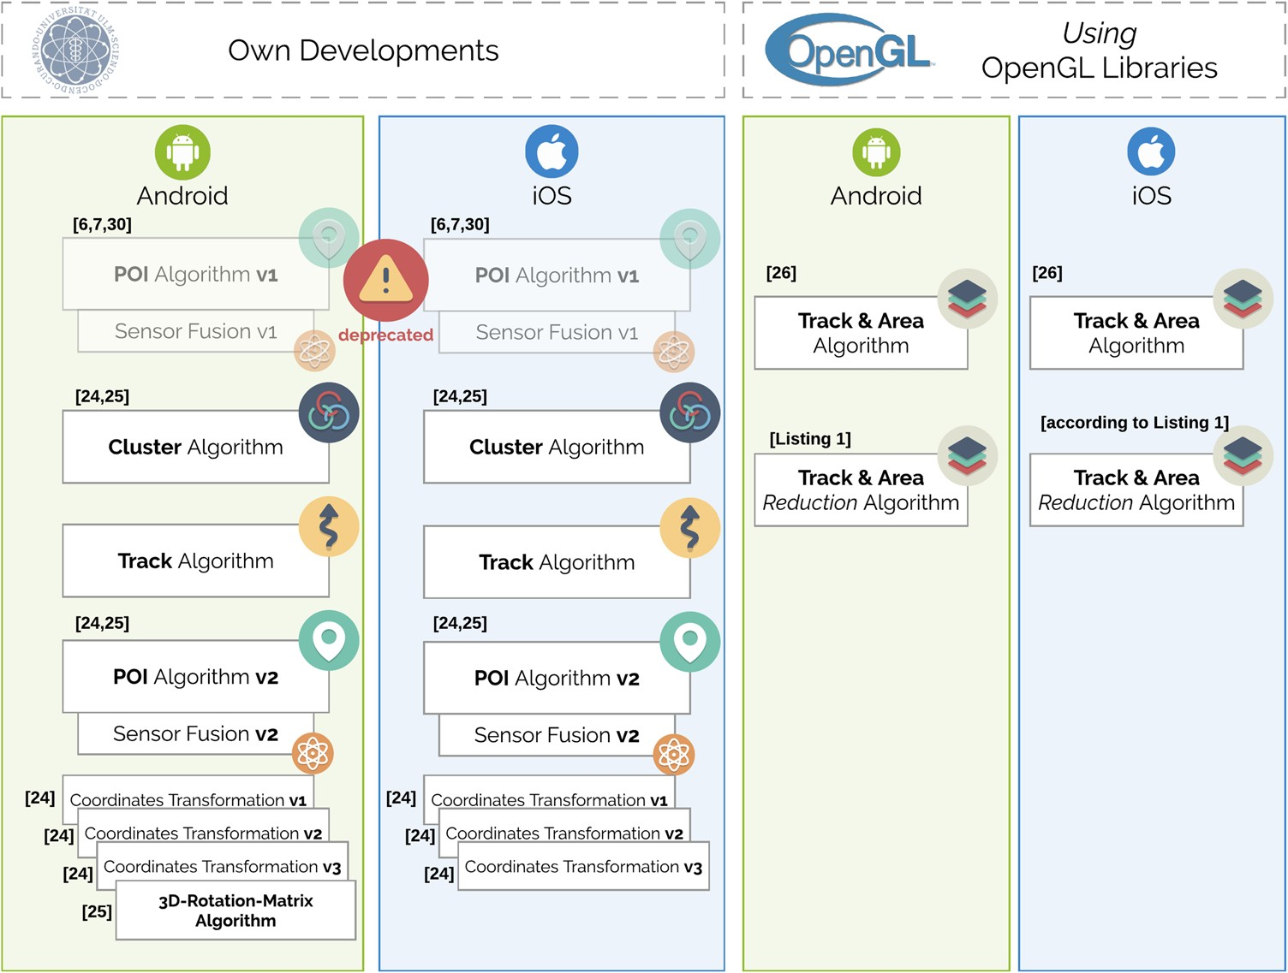
Algorithm Framework

Slide 8

Optimization of track algorithm
A virtual track of 1 km needs almost 80 KiB.
Adaptive levels of detail are needed.
Track algorithm for performance boost needs specific data structure:
Checkpoints list
degreesY list
degreesXZ list
Pairs list

Slide 9
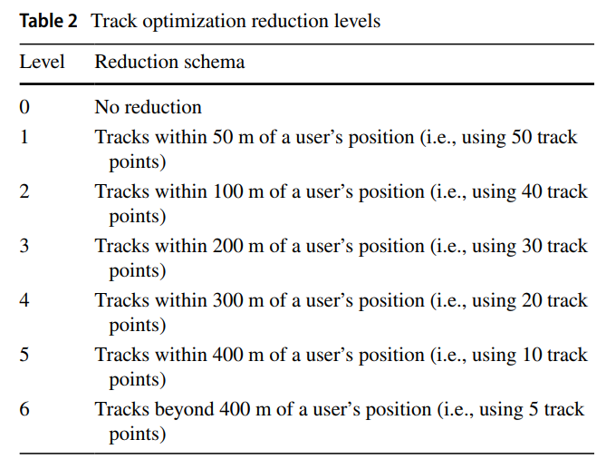
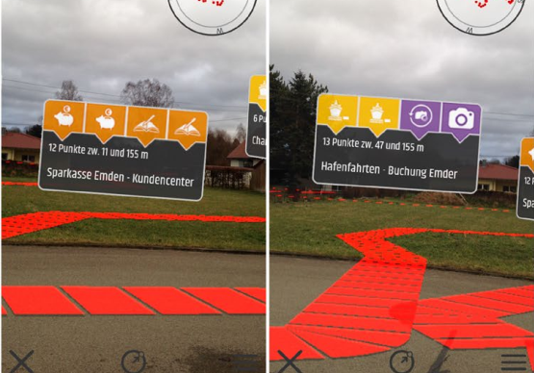
Track optimization in practice

Slide 10
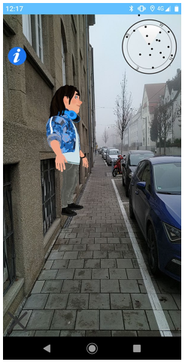
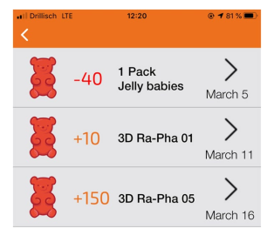
ARGame introduction
Game Goal: find the avatars spread around the city.
Credits, gained finding avatars, can be used to be redeemed in the participating stores of the city.
Users learn more about the city.

Slide 11
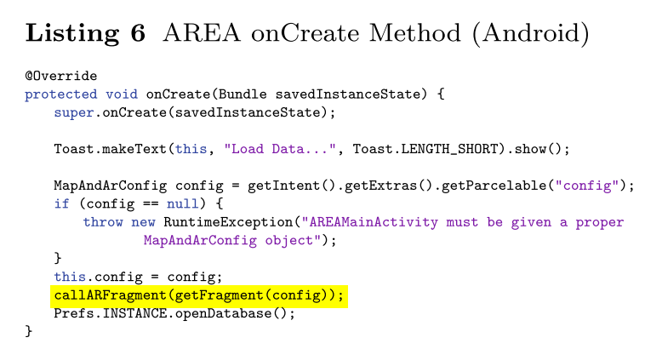
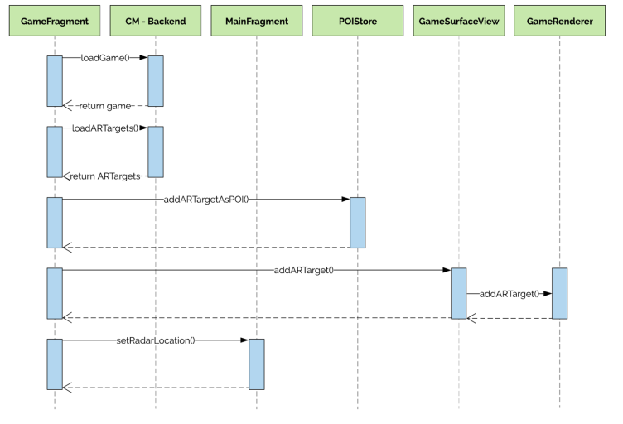
ARGame development and integration
Area20MainActivity initialization
Call sequence for Area20GameFragment

Slide 12
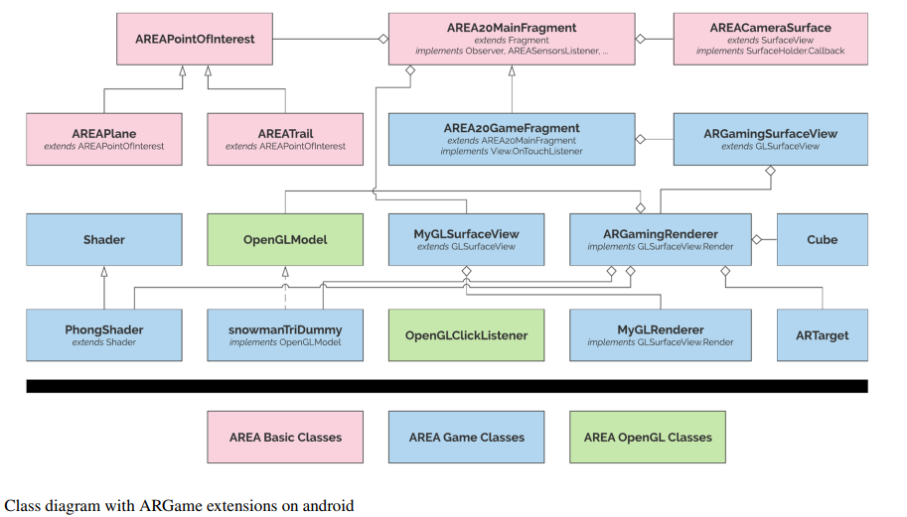
Class diagram with ARGame extensions on android

